Slide 1


Managing Organizational Changes with AI
Harnessing the power of AI to navigate the complexities of organizational change
by Akshay Damodar

Slide 2
Understanding the Impact of AI on Organizational Change
Automation
Data-driven insights
Enhanced communication
AI automates routine tasks, freeing up human resources for more strategic activities.
AI analyzes vast datasets, providing valuable insights for informed decision-making.
AI enables personalized communication, fostering employee engagement and understanding.

Slide 3

Identifying Areas for AI-Driven Process Improvement
Recruitment
Training and development
Performance management
AI can streamline the hiring process by automating candidate screening and matching.
AI-powered learning platforms provide personalized training tailored to individual needs.
AI tools can analyze employee performance data, providing objective feedback and identifying areas for improvement.

Slide 4




Leveraging AI for Enhanced Employee Communication and Support
AI Chatbots
Personalized Emails
AI-powered chatbots provide 24/7 support, answering employee queries and resolving issues efficiently.
AI analyzes employee data to personalize communication, increasing message relevance and engagement.
AI-powered Videos
AI creates engaging video content explaining changes, streamlining communication and knowledge sharing.

Slide 5
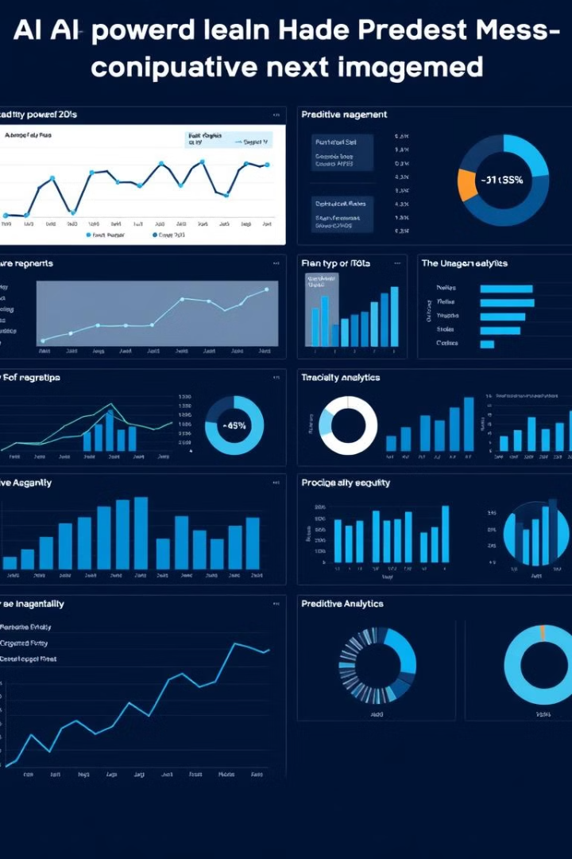
Utilizing AI-powered Predictive Analytics for Change Management
80%
90%
Reduced Resistance
Improved Success Rate
AI identifies potential roadblocks and predicts employee reactions to change.
AI-powered insights inform strategic decisions and optimize change management strategies.

Slide 6





Addressing Ethical Considerations in AI-Driven Change Management
1
Bias and fairness
2
Data privacy
3
Transparency and accountability
4
Human-AI collaboration
5
Ethical guidelines

Slide 7
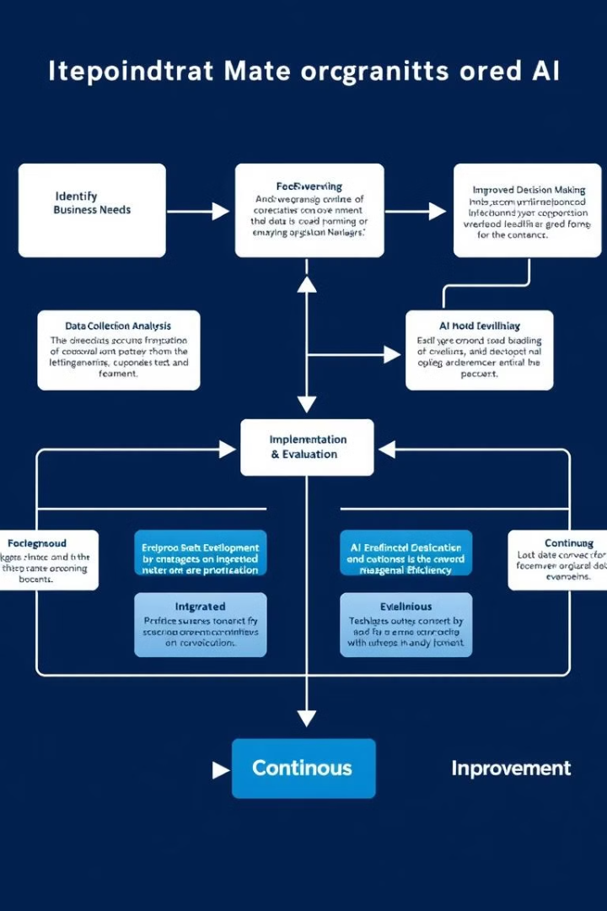



Integrating AI into Existing Management Models and Frameworks
Agile methodology
AI enhances agile practices by providing data-driven feedback loops and automating certain tasks.
Lean management
AI streamlines processes, reduces waste, and optimizes resource allocation.
Six Sigma
AI tools support data analysis, root cause identification, and process improvement efforts.

Slide 8
Building an AI-Ready Organizational Culture
1
Upskilling employees
2
Fostering collaboration
3
Open communication
4
Embracing experimentation

Slide 9



Overcoming Resistance to Change through AI-enabled Strategies

Slide 10
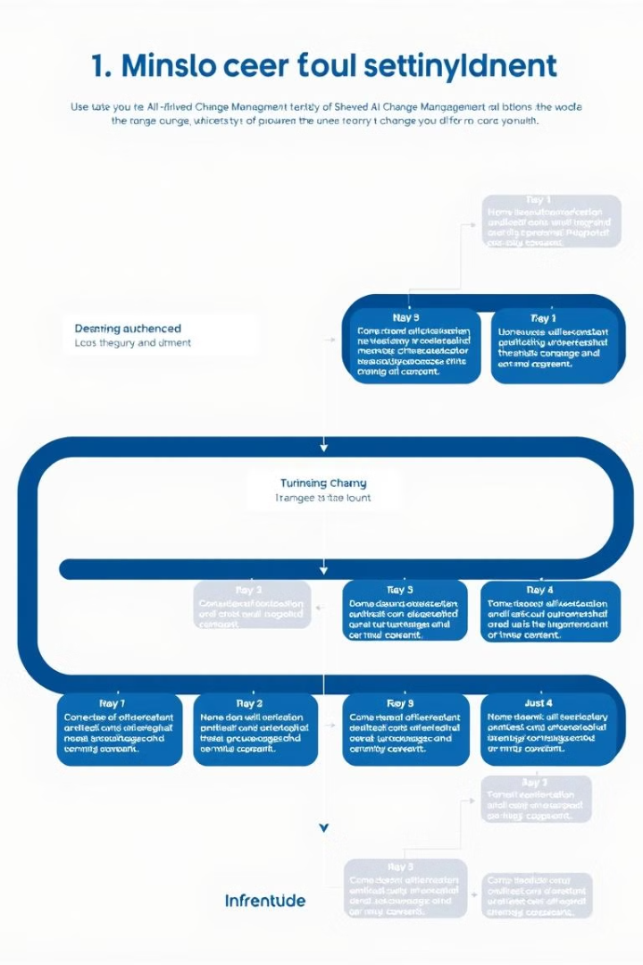
Establishing a Structured Approach for AI-driven Change Management
1
Define the scope
Clearly outline the objectives and desired outcomes of the change process.
2
Develop a roadmap
Establish a phased approach with clear milestones and timelines.
3
Pilot and refine
Test AI solutions in a controlled environment to gather feedback and optimize implementation.
4
Monitor and adapt
Continuously track progress, measure impact, and adjust strategies as needed.

